Slide 1
Probability
Probability distributions

Slide 2
Reminder
Two crucial elements:
Support
"Criterion" for generating objects
We can define a criterion (function) as long as it satisfies:
The probability of the entire universe (support) must be 1
All events must have positive probability

Slide 3
Parametric families

Slide 4
Probability functions
We can always make a rule from scratch.
But there exist known functions for certain things that simplify behavior through parameters.
The functions that define these random variables are usually called parametric families
The question they answer is: what is the probability that the value x appears?

Slide 5
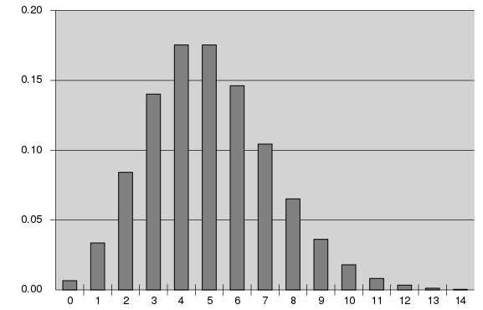
Discrete distributions

Slide 6
Coin
Instead of Heads and Tails think of "success" or "failure". Or better yet 1 and 0.
Experiment: Flip the coin once
With probability p we have success (1 comes up) and with probability 1−p we fail (0 comes up)
As a probability function: 1 has probability p and 0 has probability 1−p
Or equivalently

Slide 7
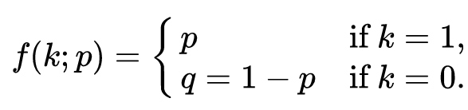
Coin
Instead of Heads and Tails think of "success" or "failure". Or better yet 1 and 0.
Experiment: Flip the coin once
With probability p we have success (1 comes up) and with probability 1−p we fail (0 comes up)
As a probability function: 1 has probability p and 0 has probability 1−p
Or equivalently

Slide 8

Coin — Bernoulli
Ideally an analytical function so we can do calculations with it
We need an equation that gives us p if we put in a 1 and 1−p if we put in a 0
Only valid on the support!

Slide 9
Repeating the coin
If we flip the coin many times (e.g. 10), we can ask:
What is the probability of 3 successes?
What is the support?
We have the probability of each success: p

Slide 10
Repeating the coin
If we flip the coin many times (e.g. 10), we can ask:
What is the probability of 3 successes?
We have the probability of each success: p
Since each flip is independent, we can use the rule: P(A and B) = P(A)*P(B)
So P(3 successes) = p*p*p = p³

Slide 11
Repeating the coin
If we flip the coin many times (e.g. 10), we can ask:
What is the probability of 3 successes?
We have the probability of each success: p
Since each flip is independent, we can use the rule: P(A and B) = P(A)*P(B)
So P(3 successes) = p*p*p = p³
But we also need the other 7 flips to be failures
P(7 failures) = (1−p)*(1−p)*(1−p)*(1−p)*(1−p)*(1−p)*(1−p) = (1−p)⁷

Slide 12
Repeating the coin
Thus:
P(3 successes then 7 failures) = p³(1−p)⁷
But it isn't the only way to get 3 successes and 7 failures
0001111111
0010111111
0011011111
….

Slide 13
Repeating the coin — Binomial
This causes some counts of successes to occur more often than others:
If 10 successes, only one combination: 1111111111
If 9 successes, it can come out in 10 different ways: 0111111111, 1011111111, 1101111111, …, 1111111101, 1111111110

Slide 14


Repeating the coin — Binomial
This causes some counts of successes to occur more often than others:
If 10 successes, only one combination: 1111111111
If 9 successes, it can come out in 10 different ways: 0111111111, 1011111111, 1101111111, …, 1111111101, 1111111110
For this there is the binomial coefficient. It counts combinations
In how many ways can we observe k successes in n experiments?

Slide 15
Repeating the coin — Geometric
We could also ask:
What is the probability of observing 9 failures before the first success?
What is the support?

Slide 16
Repeating the coin — Geometric
We could also ask:
What is the probability of observing 9 failures before the first success?
Here order matters, only one option:
P(k=9; p=½) = (1−p)⁹p
In general
P(k; p=½) = (1−p)^{k}p

Slide 17
Discrete distributions
Bernoulli — Success or failure
Binomial — Number of successes in n trials
Geometric — Number of failures before the first success
Negative Binomial — Number of failures before observing r successes
Categorical — Generalization of Bernoulli (with more than 2 cases)
Example: A person can be classified under some personality profile
Multinomial — Generalization of binomial (with more than 2 cases)
Example: Distribution of personalities in a classroom

Slide 18
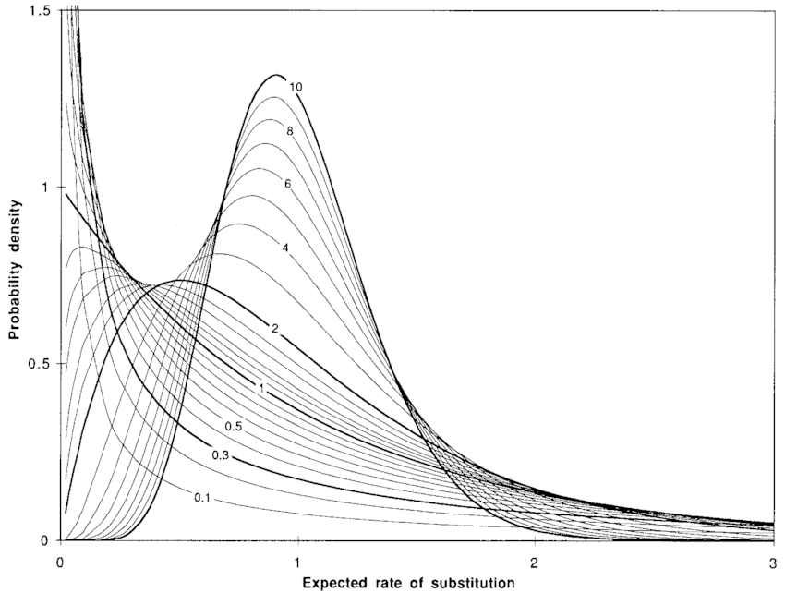
Continuous distributions

Slide 19
Motivation
Discrete distributions arise from relatively simple processes found in reality.
Continuous distributions try to approximate behaviors (in real life there are no truly continuous measurements).
As in discrete, what guides us most is:
The support
The possible shapes

Slide 20
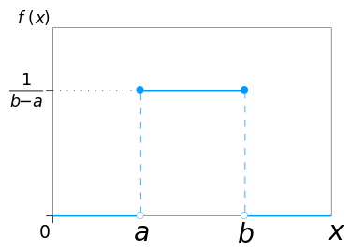
Uniform
Support: from a to b
Parameters: a and b

Slide 21
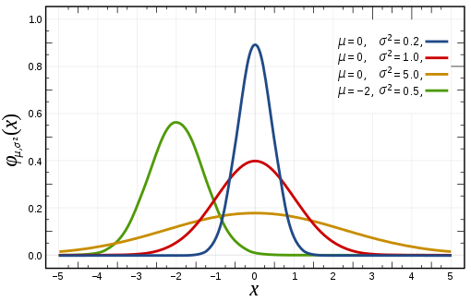
Normal distribution
Support: −infinity, infinity (all numbers)
Parameters: mu and sigma
Shape: Symmetric, unimodal
Example: Measurement errors

Slide 22
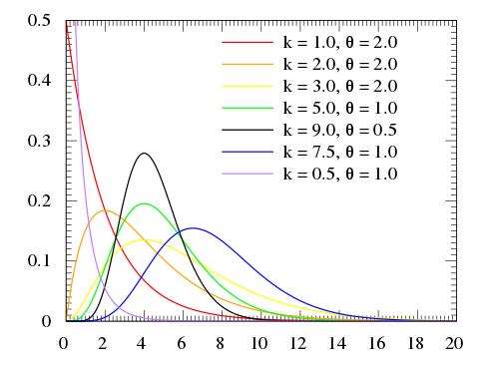
Gamma
Support: 0, infinity
Parameters: location, scale
Example: Reaction times

Slide 23
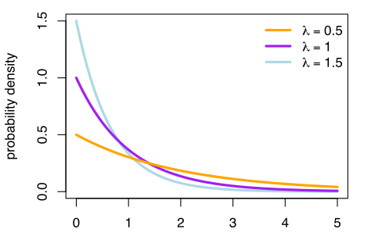
Exponential
Support: 0 to infinity
Parameters: λ
Shape: decreasing
Example: Survival

Slide 24
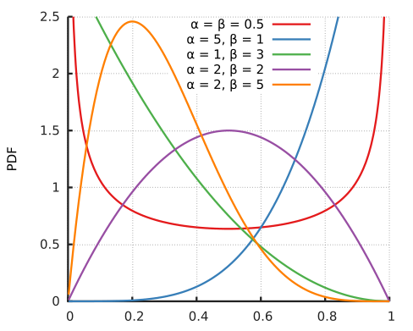
Beta
Support: 0 to 1
Parameters: alpha and beta
Examples: Fraction of a project's time taken by a development step. Probability

Slide 25
Real-life examples

Slide 26
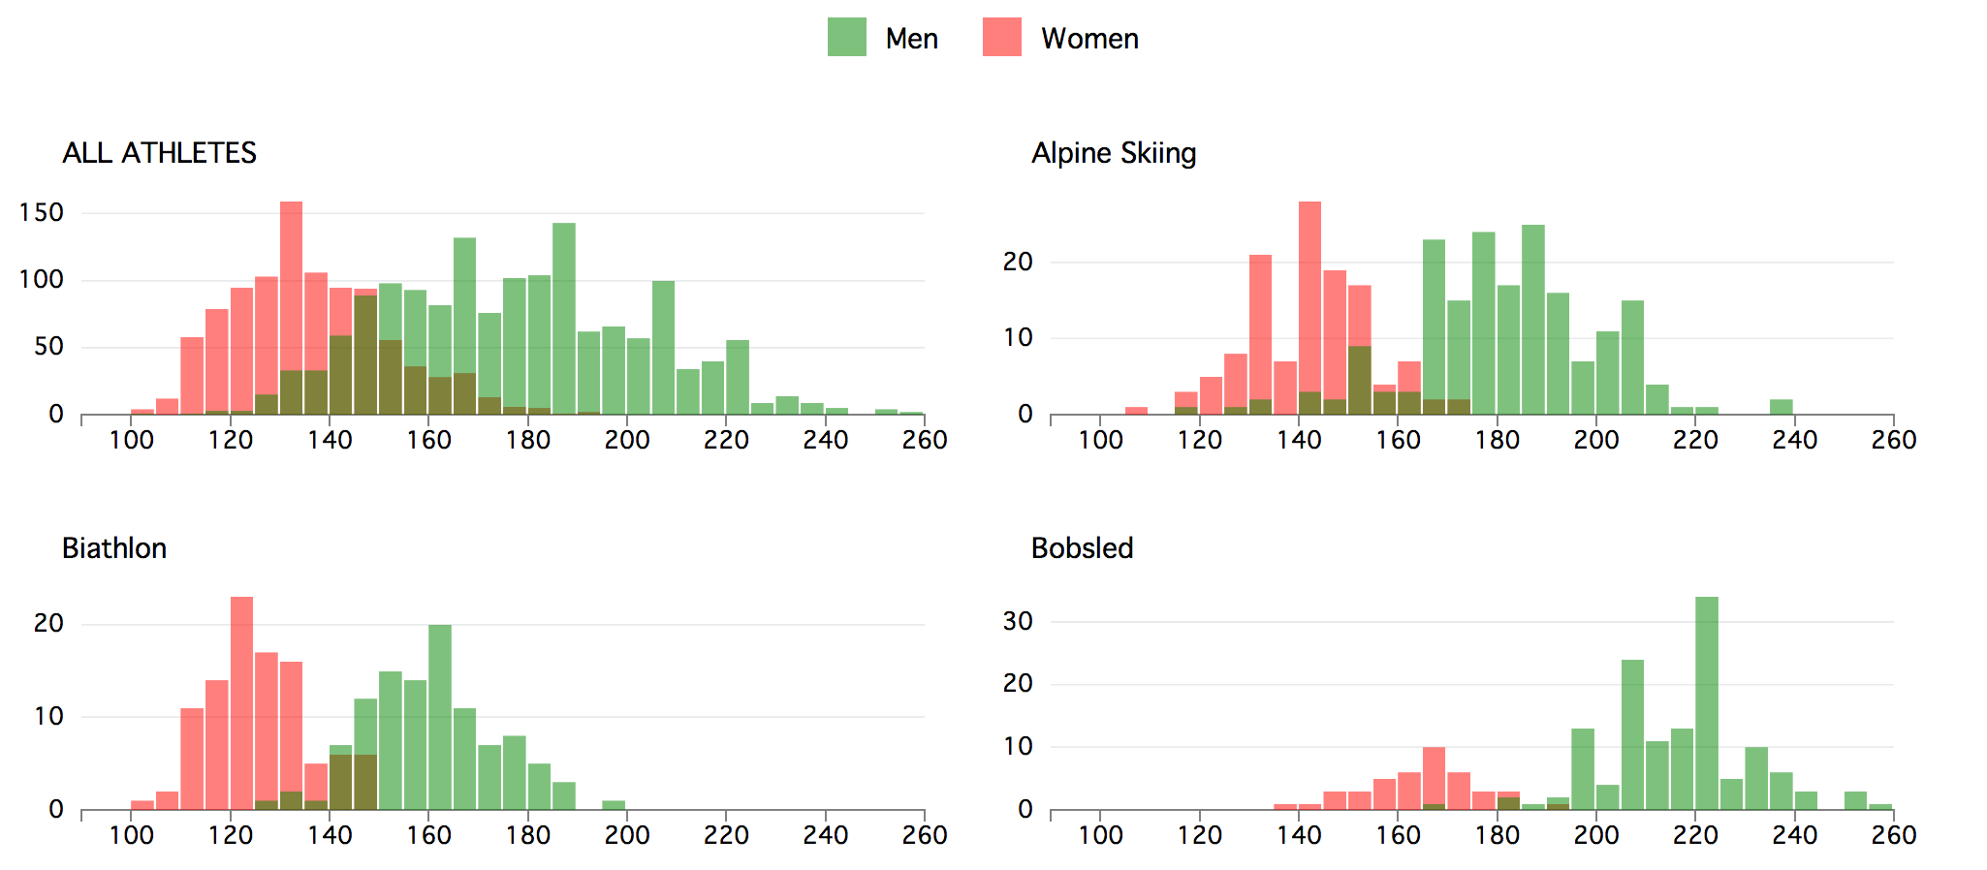
Olympic athletes' heights

Slide 27
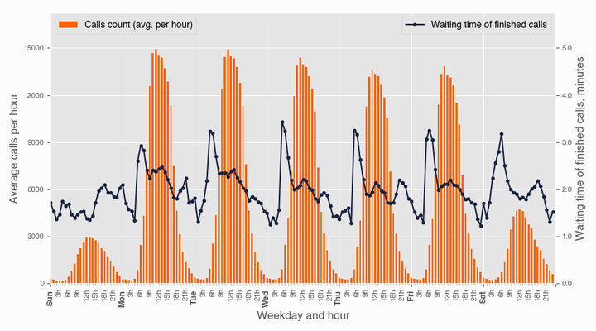
Number of calls in a Call Center

Slide 28
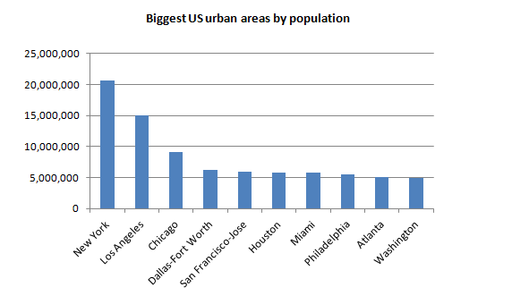
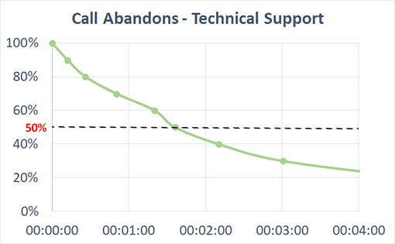
Waiting times in a Call Center

Slide 29
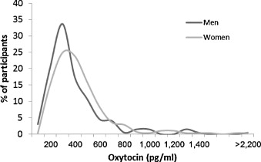
Oxytocin level

